Slide 1
SQL
Structured query language
Presented By:
Lavanya
Prasanna
Poornima
Niharika
Menaka
Under Guidance:
D Veera
(Besant Tech)

Slide 2

VeeraQtech
Project Title:

Slide 3
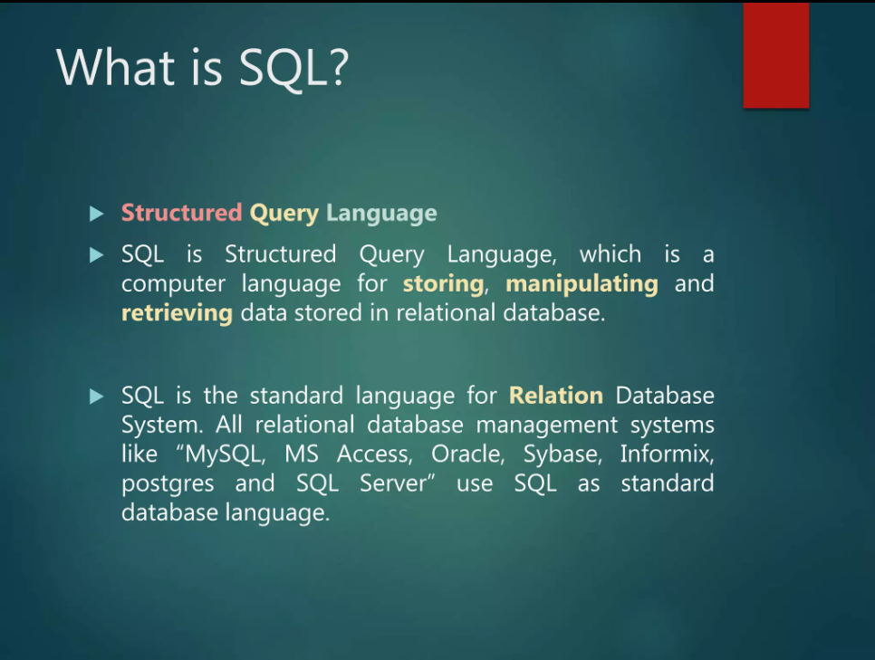

Slide 4


Slide 5
What is VEERAQTECH ?
VeeraQtech is a startup that works in the Data Science field. VeeraQtech has worked on fraud detection, market basket, self-driving cars, supply chain, algorithmic early detection of lung cancer, customer sentiment, and the drug discovery field. With the annual appraisal cycle around the corner, the HR department has asked us (Junior Database Administrator) to generate reports on employee details, their performance, and on the project that the employees have undertaken, to analyze the employee database and extract specific data based on different requirements.

Slide 6
Objective
To facilitate a better understanding, managers have provided ratings for each employee which will help the HR department to finalize the employee performance mapping. As a DBA, I should find the maximum salary of the employees and ensure that all jobs are meeting the organization's profile standard. You also need to calculate bonuses to find extra cost for expenses. This will raise the overall performance of the organization by ensuring that all required employees receive training.

Slide 7

How is SQL used in VEERAQTECH ?
With SQL we can execute queries against a large database system to extract certain piece of information.

Slide 8
Employee Record
Data Science Team
Projects

Slide 9
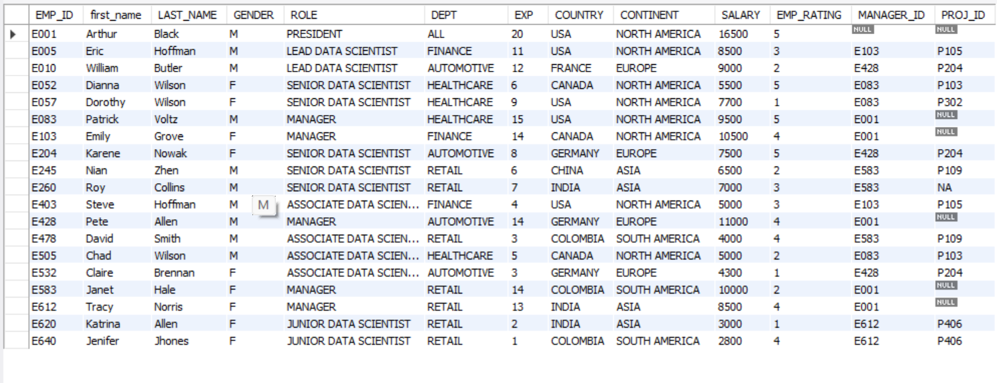
Employees Record

Slide 10
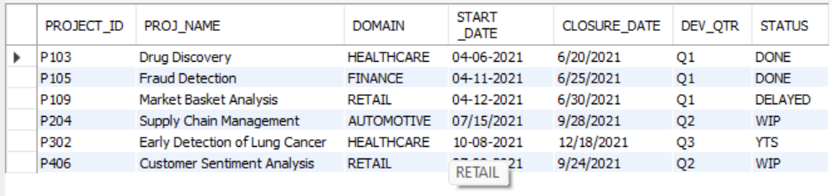
Projects

Slide 11
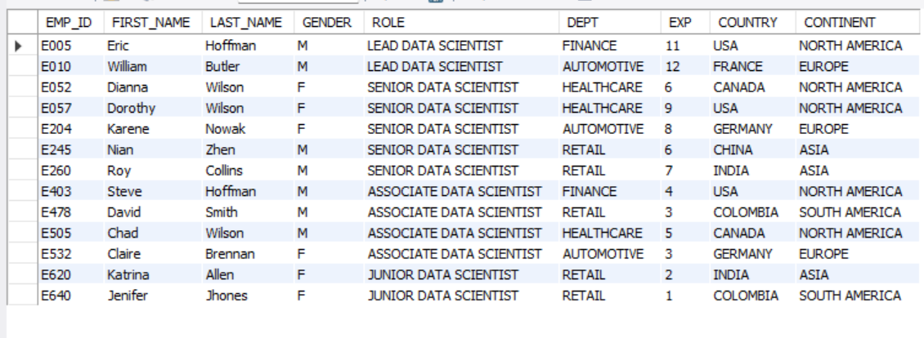
Data science team

Slide 12
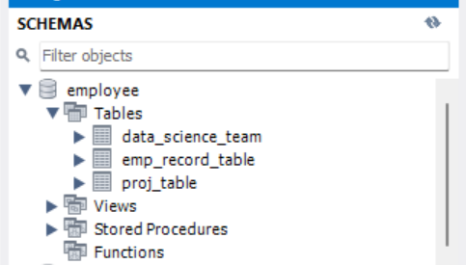
Create a database named employee, then import data_science_team.csv proj_table.csv and emp_record_table.csv into the employee database from the given resources.
Create database employee;
Imported tables by using “Table Data Import Wizard”:

Slide 13
Write a query to fetch EMP_ID, FIRST_NAME, LAST_NAME, GENDER, and DEPARTMENT from the employee record table, and make a list of employees and details of their department ?
SELECT emp_id, first_name, last_name, gender, dept FROM emp_record_table;

Slide 14
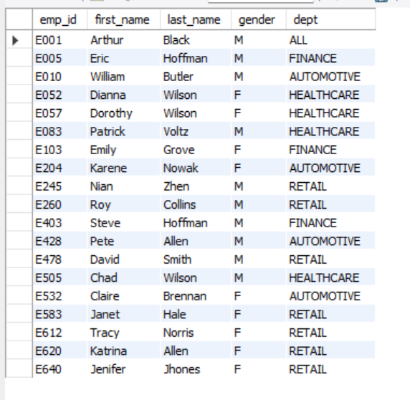
Output:

Slide 15
Write a query to fetch EMP_ID, FIRST_NAME, LAST_NAME, GENDER, DEPARTMENT, and EMP_RATING if the EMP_RATING is ?
SELECT emp_id, first_name, last_name, gender, dept, emp_rating FROM emp_record_table WHERE emp_rating < 2 or emp_rating > 4 or (emp_rating > 2 and emp_rating < 4);

Slide 16
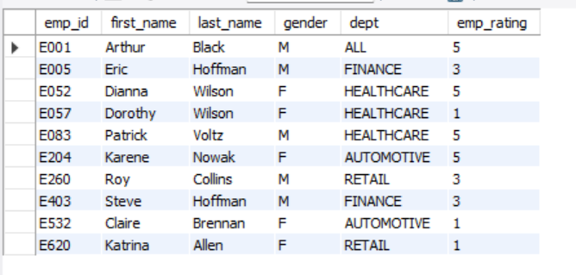
Output:

Slide 17
Write a query to concatenate the FIRST_NAME and the LAST_NAME of employees in the Finance department from the employee table and then give the resultant column alias as NAME ?
SELECT CONCAT(FIRST_NAME, ' ', LAST_NAME) AS NAME FROM emp_record_table WHERE DEPT = 'Finance';

Slide 18
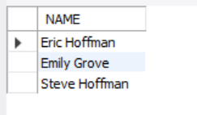
Output:

Slide 19
Write a query to list only those employees who have someone reporting to them. Also, show the number of reporters (including the President) ?
SELECT * FROM emp_record_table WHERE EMP_ID IN (SELECT MANAGER_ID FROM emp_record_table);

Slide 20
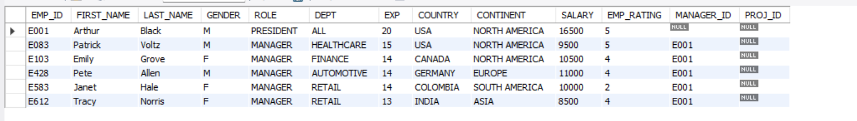
Output:

Slide 21
Write a query to list down all the employees from the healthcare and finance departments using union. Take data from the employee record table ?
SELECT * FROM emp_record_table WHERE DEPT = 'Healthcare’ UNION
SELECT * FROM emp_record_table WHERE DEPT = 'Finance';

Slide 22
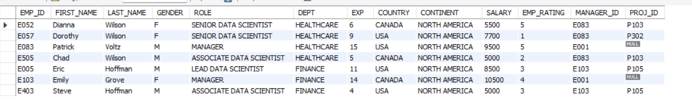
Output:

Slide 23
Write a query to list down employee details such as EMP_ID, FIRST_NAME, LAST_NAME, ROLE, DEPARTMENT, and EMP_RATING grouped by dept. Also include the respective employee rating along with the max emp rating for the department ?
SELECT EMP_ID, FIRST_NAME, LAST_NAME, ROLE, DEPT, EMP_RATING, MAX(EMP_RATING) OVER (PARTITION BY DEPT) AS MAX_RATING FROM emp_record_table GROUP BY DEPT, EMP_ID, FIRST_NAME, LAST_NAME, ROLE, EMP_RATING;

Slide 24
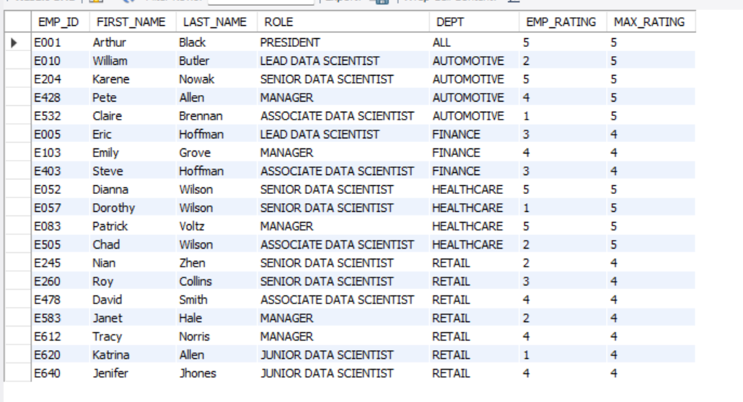
Output:

Slide 25
Write a query to calculate the minimum and the maximum salary of the employees in each role. Take data from the employee record table ?
SELECT ROLE, MIN(SALARY) AS MIN_SALARY, MAX(SALARY) AS MAX_SALARY FROM emp_record_table GROUP BY ROLE;

Slide 26
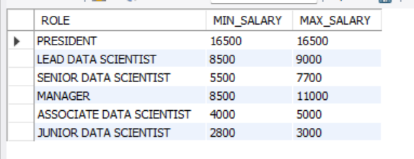
Output:

Slide 27
Write a query to assign ranks to each employee based on their experience. Take data from the employee record table ?
SELECT EMP_ID, FIRST_NAME, LAST_NAME, EXP,
RANK() OVER (ORDER BY EXP DESC) AS EXPERIENCE_RANK
FROM emp_record_table;

Slide 28
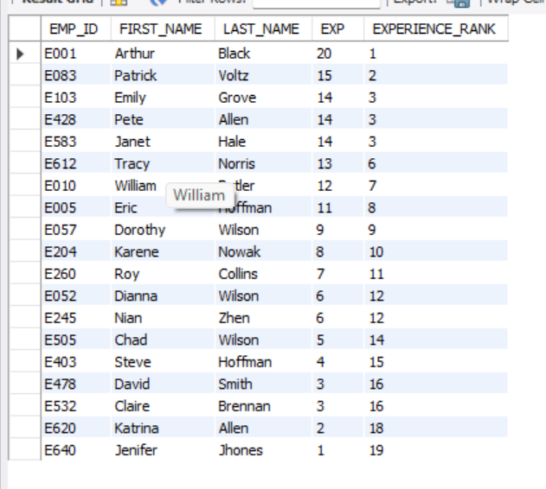
Output:

Slide 29
Write a query to create a view that displays employees in various countries whose salary is more than six thousand. Take data from the employee record table ?
CREATE view High_salary_employees AS
SELECT emp_id, first_name, last_name, country
FROM emp_record_table
WHERE salary>6000;

Slide 30
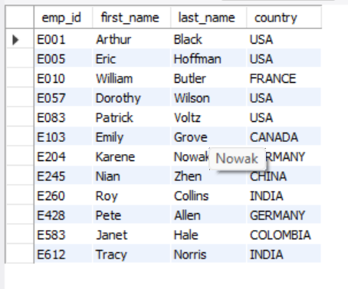
Output:

Slide 31
Write a nested query to find employees with experience of more than ten years. Take data from the employee record table ?
SELECT * FROM Emp_record_table
WHERE exp>10;

Slide 32
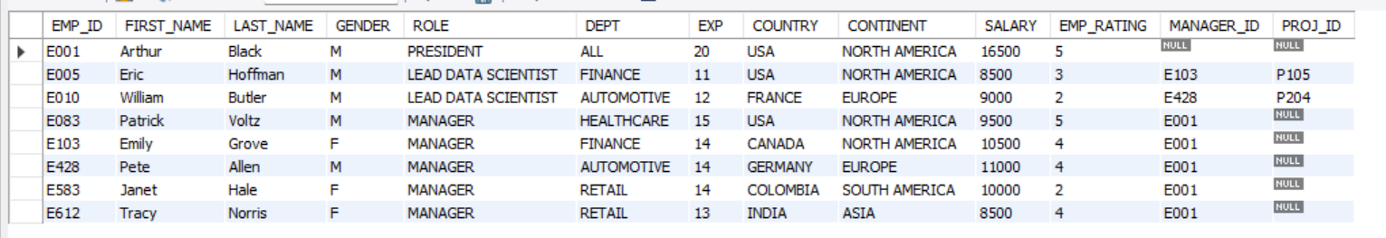
Output:

Slide 33
Write a query to create a stored procedure to retrieve the details of the employees whose experience is more than three years. Take data from the employee record table ?
CREATE PROCEDURE `Experienced_Employees`()
BEGIN
SELECT * FROM Emp_record_table WHERE exp > 3;
END

Slide 34
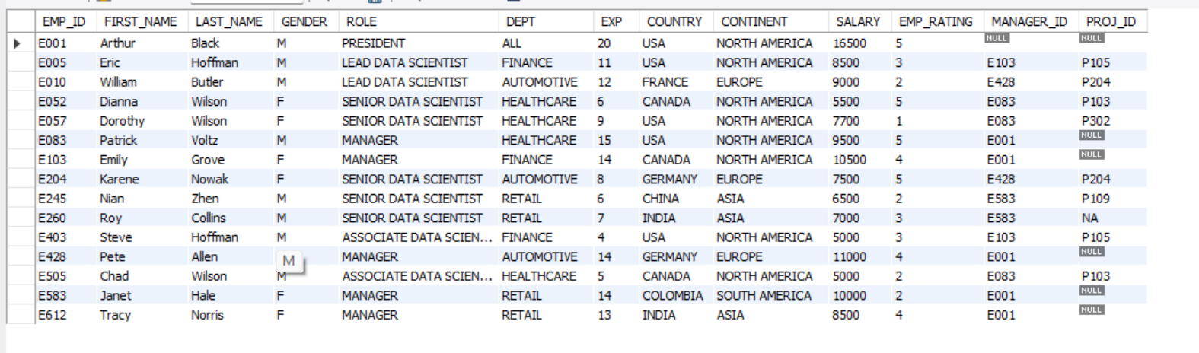
Output:

Slide 35
Create an index to improve the cost and performance of the query to find the employee whose FIRST_NAME is ‘Eric’ in the employee table after checking the execution plan ?
CREATE INDEX idx_First_Name ON emp_record_table(first_name);
Output:

Slide 36
Write a query to calculate the bonus for all the employees, based on their ratings and salaries (Use the formula: 5% of salary * employee rating) ?
SELECT EMP_ID, FIRST_NAME, LAST_NAME, (0.05 * SALARY * EMP_RATING) AS BONUS
FROM emp_record_table;

Slide 37
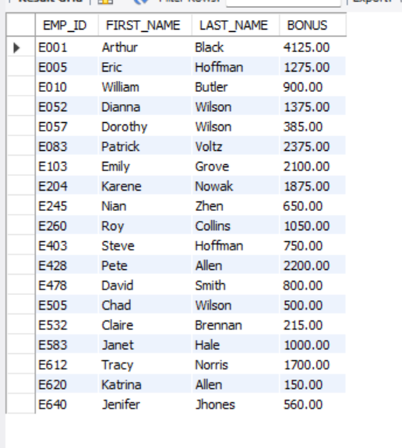
Output:

Slide 38
Write a query to calculate the average salary distribution based on the continent and country. Take data from the employee record table ?
SELECT CONTINENT, COUNTRY, AVG(SALARY) AS AVG_SALARY
FROM emp_record_table
GROUP BY CONTINENT, COUNTRY;

Slide 39
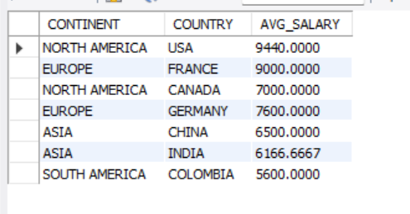
Output:

Slide 40



